Slide 1
HTML (Hyper Text Markup Language)
What is Hyper Text?
Hyper means “beyond”
Hyper text resembles text that contains content beyond what we see.
What is a Markup Language?
The markup is derived from common computer terminology, where “marking up” is the process of preparing for presentation.
Markup language is a presentation language.

Slide 2
Evolution of Markup Languages
GML [Generic Markup Language] at “CERN” Labs
SGML [Standard Generic Markup Language]
Early 1990’s “Tim Berners Lee” introduced “HTML” for “Mosaic” browser.
IETF (Internet Engineering Task Force) 1993
1995 HTML 2.0
1997 HTML 3.2
1997 HTML 4.0
2014 HTML 5.0
2017 HTML 5.2 [W3C and WHATWG] Web Hypertext Application Technology Work Group World Wide Web Consortium

Slide 3
What is DHTML?
Dynamic HTML. [Obsolete – No Longer in use]
What is HTML?
It is a markup language.
It is used for presentation.
HTML is used to present DOM.

Slide 4
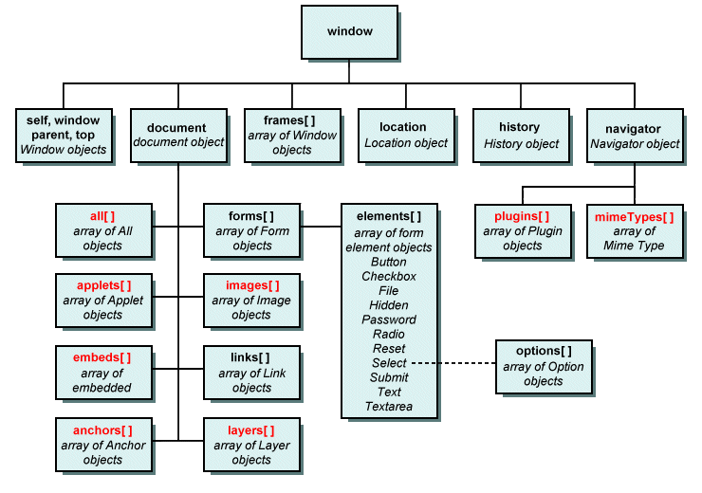
What is DOM?

Slide 5
Browser presents content in a hierarchy called DOM.
Document Object Model
It is a hierarchy used to present contents in HTML.
What is Static DOM and Dynamic DOM?
The DOM which is initially loaded by HTML is static.
HTML can present static DOM.
Static DOM can’t handle interactions.
JavaScript, jQuery, Angular JS, React etc. are used to convert the static DOM into dynamic DOM.
How HTML Presents the DOM?
By using Elements

Slide 6
What are the elements used for presenting DOM?
Normal Elements
Void Elements
RC Data Elements
Raw Text Elements
Foreign Elements

Slide 7
Normal Elements
- Elements which return a presentation directly on call back [without any additional attributes].
- Elements in HTML are built by using tags.
- Normal Elements require a start tag and end tag.
- Normal Elements will start returning presentation but can’t stop implicitly.
- They require explicit end tag.
- Usually require start and end tags.
Ex:
<b> Bold </b>

Slide 8
Void Elements
The term void refers to element that doesn’t return any presentation directly on call back.
Void means no return type.
They can return only the specific content and stop implicitly.
Void elements doesn’t require “End Tag”. Ex: <img> tag Image – Element

Slide 9
RC Data Elements
Rich Content Elements
These elements will not allow any another element with in the context. Ex: <textarea> </textarea>
Raw Text Elements
These elements are presented without a tag.
Ex:
&copy; ©
&#8377; ₹
Foreign Elements
These are HTML elements used in HTML but requires additional library.
Every browser can’t understand these elements.
You have to import a library that makes the browser compatible with element. Ex:
SVG, MathML, Canvas

Slide 10
What is Element and What is Tag?
HTML presents using Elements.
Elements are built by using Tags. Image - Element <img> - Tag
Anchor - Element <a> - Tag
Bold - Element
<b> - Tag

Slide 11
Structure of HTML Page
Every HTML page comprises of 2 sections at high level
Document Declaration
Document Scope
Document Declaration:
It comprises of information about HTML version.
It informs the parser that we are using HTML 5 to design web page.
The document declaration in HTML 5 is defined by using the following Entity <!DOCTYPE html>
Note: Comments in HTML are written with in “<!-- your comments -->”

Slide 12
Document Scope:
It specifies the boundary of HTML document.
It defines the start and end of every document in browser.
Document scope in HTML is defined by using <html> </html>
Every document scope must specify which language content it is presenting.
Language is defined by using the attribute “lang” <html lang=”en-in”>
</html>

Slide 13
Sections in HTML document scope
Every HTML document scope comprises of 2 major sections
Head Section
Body Section
Head Section:
Head section comprises of content, which is intended to load into memory when page is requested by client.
The content from memory of browser can be accessed by page or browser when ever required.
Typically head section is defined with <head> </head>
It comprises of contents like: Title,Link,Meta,Script,Style

Slide 14
Title Element:
It comprises of title, which is displayed in the browser title bar.
The title is also used in bookmarking the page.
<html lang="en-IN">
<head>
<title>Amazon Shopping</title>
</head>
</html>
Link Element:
It is used to link external files to your web page.
External files include short cut icons, stylesheets etc.

Slide 15
Ex: Link Shortcut Icon to Web Page [Favicon]
Favicon must be an “icon” file with extension “.ico”
Size of icon is between 16x16 pixels and 32x32 pixels
Create a new folder by name “Icons” in your project.
Add a new file into “Icons” folder by name “favicon.ico”
Right Click on Icons folder and “Reveal in Explorer”
Right Click on “icon file” and select “Open with Paint”
Set the page size 32 x 32 pixels
Design your icon
Save
Go to your web page and link the icon file

Slide 16
Ex.
<html lang="en-IN">
<head>
<title>Amazon Shopping</title>
<link rel="shortcut icon" href="Icons/favicon.ico">
</head>
</html>
Note: Never use physical path directly in web development.
FAQ: When to use “\” back slash “/” forward slash?
Virtual Path: “/” forward slash “Icons/favicon.ico”
Physical Path: “\” back slash “C:\Icons\Favicon.ico”

Slide 17
Meta in Head Section
The terms meta refers to “Meta Data”.
Meta Data contains information about your page, which is provided to SEO [Search Engine Optimization] to make the page more SEO friendly.
Meta is one of the options used in SEO. It Is not only the option for SEO.
Meta is also used for Responsive Pages. It is not only the options for Responsive.

Slide 18
<!--Document declaration-->
<!DOCTYPE html>
<!--Document Scope-->
<html lang="en-IN">
<head>
<title>Amazon Shopping</title>
<link rel="shortcut icon" href="../Icons/favicon.ico">
<meta charset="utf-8">
<meta name="keywords" content="Best Software Traning, Best IT Training, in Hyd, Chennai, US">
<meta name="description" content="something about your website..">
<meta name="author" content="Author Name for Blog">
<meta http-equiv="refresh" content="4">
</head>
</html>

Slide 19
Body Section
It comprises of content to display in browser workspace.
The body section is configured by using “<body>” element. Syntax: <body> Some content </body>
Body tag comprises following attributes:-
Attribute | Description
bgcolor | It sets a background color for page.
text | It sets color for text in page. [Foreground color] Ex: <body bgcolor="red" text="yellow"> Welcome to Amazon Shopping </body>

Slide 20
background | It sets a background image for body section. Ex: <body background="../Images/banner3.jpg" text="white"> Welcome to Amazon Shopping </body>
alink | It defines color for active link.
vlink | It defined color for visited link. Ex: <body vlink="green" alink="red"> <a href="home.html">Home</a> <a href="http://www.amazon.in">Amazon</a> </body>
leftmargin | Sets the space between the content and browser window. Ex: <body leftmargin="50" rightmargin="50" topmargin="50" bottommargin="20"> Some paragraph.. </body>
rightmargin
topmargin
bottommargin

Slide 21
align | It aligns the entire body content to left, center, right or justify Ex: <body align=”justify”> </body>

Slide 22
Semantics of HTML Body
Semantic elements are the elements used for a generic purpose.
HTML 5 body section introduced new semantics that can make body content more SEO friendly.
HTML 5 body section related semantic elements are container elements.
A container comprises of content like text, headings, tables, pictures etc.

Slide 23
aside | It is a container used to define content, which is not relative to current website.
article | It is a container used to define content, which is relative to the current website and which summarizes the topics.
dialog | It is a container, which can popup and allow interactions with page.
figure | It is used to encapsulate any image with caption.
figcaption | It is used to define a caption for image.
header | It defines the content to display at the top margin of page.
footer | It defines the content to display at the bottom margin of page.
section | It defines the content between header and footer.
main | It defines the main content in section.
nav | It defines the navigation area.
menu | It defines the items used for navigation.
div | It is a container used for division of content in page.
span | It is a container used to span with existing content.

Slide 24
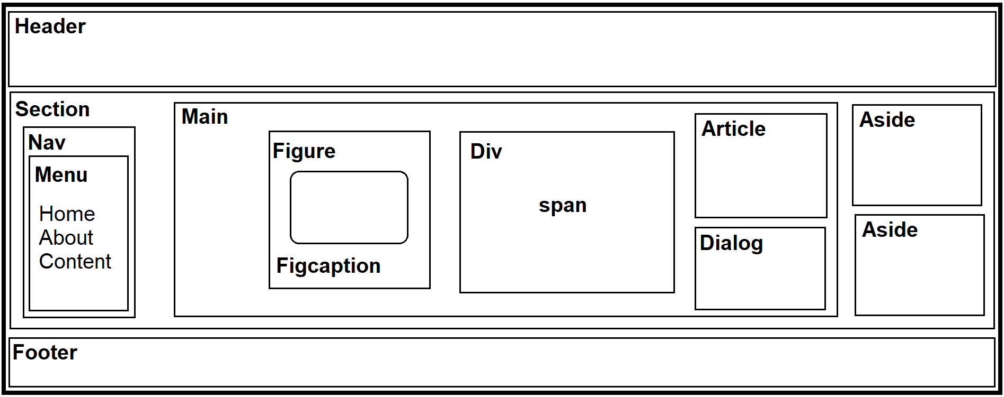
Assignment:
Make a Website layout as following:

